Slide 1
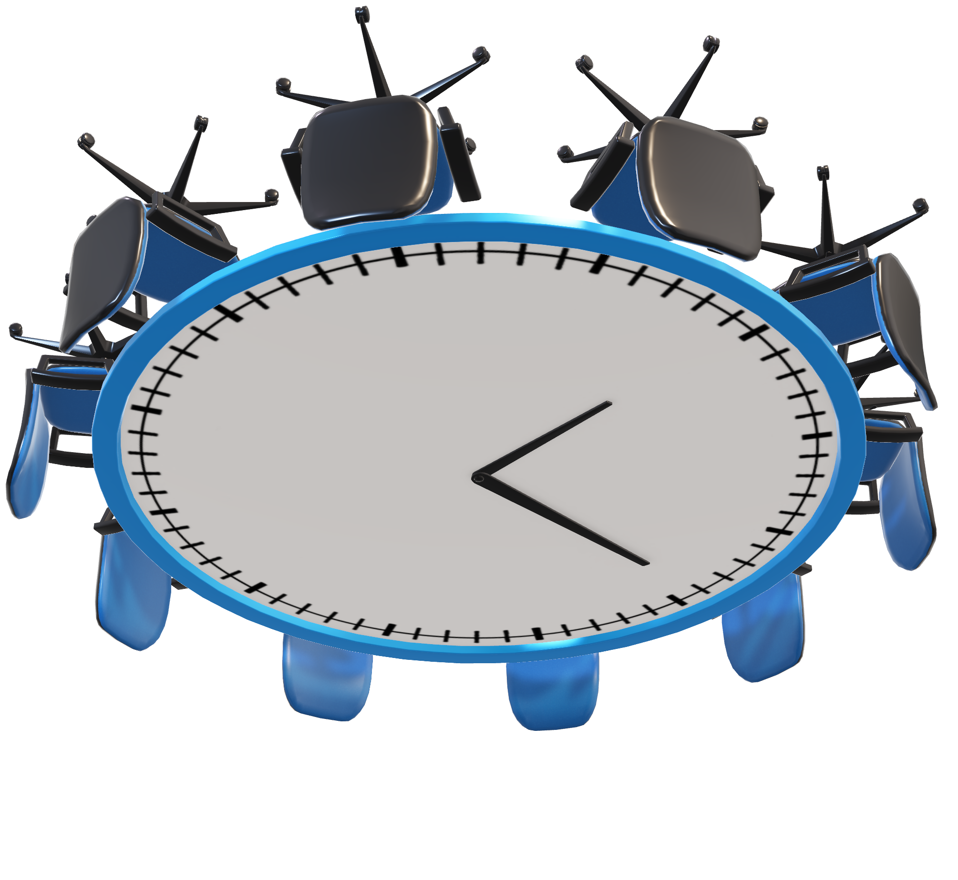
Project Demo Smart-fin
Date : 07/11/24
Organizational Income and Expense Tracking System

Slide 2

Project Demo Smart-fin
Organizational Income and Expense Tracking System
Date : 07/11/24

Slide 3

Agenda
Project overview
Core features
Technology stack
Architecture overview
Key integrations
Challenges and solutions
Future enhancements

Slide 4


Project Overview
Goal: To develop a comprehensive financial management platform to help organizations efficiently track income, expenses, employee roles, attendance, and project financials.
Objective:
Provide data-driven insights for informed decision-making and operational efficiency.
Streamline financial reporting and ensure real-time financial visibility.
Enhance security through role-based access control.

Slide 5


User-Specific Features
Organization Head Features:
Global and project-specific income and expense tracking.
Real-time financial dashboard with performance summaries.
Manage organization details and oversee role-based access control.
Project Manager Features:
Assign employees to projects and track project budgets and expenses.
Access detailed project-specific financial reports.
Ensure budget utilization aligns with project goals.
Finance Manager Features:
Manage income and expense records, generate invoices, and process transactions.
Generate financial analytics reports to provide insights into project performance.

Slide 6





Technology Stack
Frontend:
UI Framework: React with TypeScript.
Components: Chakra UI for a responsive, user-friendly interface.
Backend:
Framework: Node.js with TypeScript.
Architecture: Microservices for organization, project, employee, and analytics services.
Role Management: Implemented user roles for secure, role-based data access.

Slide 7



Technology Stack
Authentication & Authorization:
JWT (JSON Web Tokens) for secure user authentication and authorization.
Ensures role-based access control (RBAC) to data and functionality, based on user roles (Admin, Project Operational Manager, Finance Team, Employees).
Database:
MongoDB for document-based storage.
Mongoose for schema modelling.

Slide 8
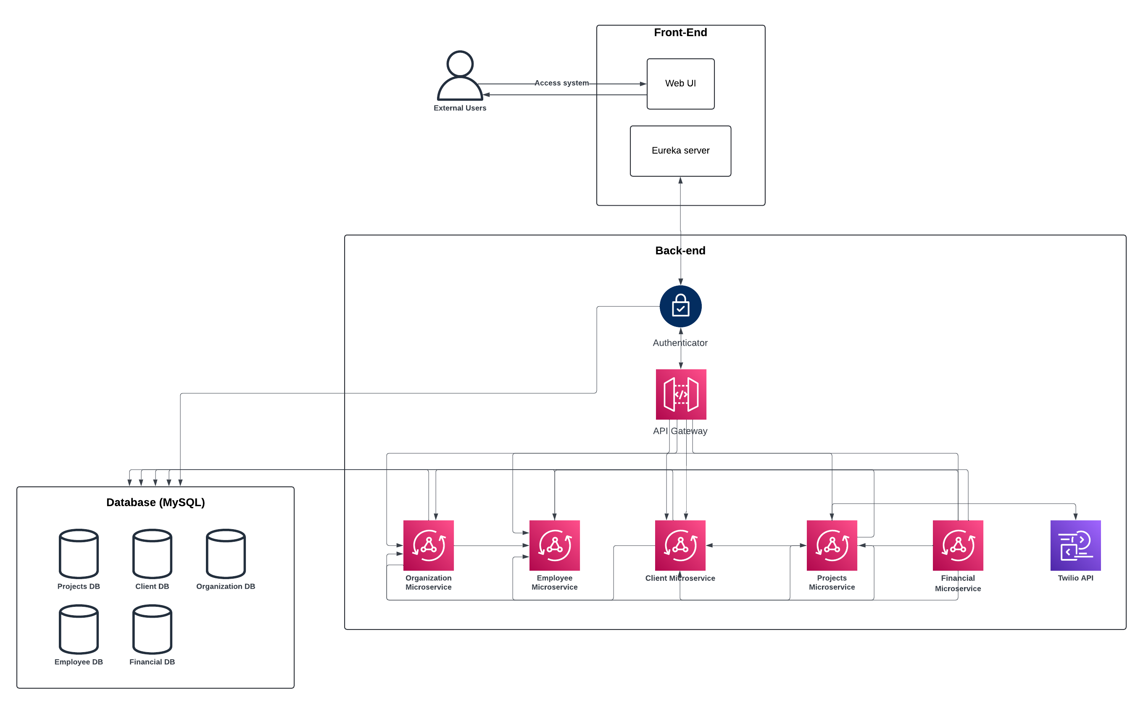
Architecture Overview

Slide 9
Project timeline
Oct 24 - Initiation
Project kickoff and requirements gathering.
Oct 26 - Planning
Set project scope, roles, and resources.
Oct 27 - Execution
Develop core features and integrate services.
Nov 3 – Control
Testing and quality assurance.
Nov 5 – Closure
Final fixes, deployment, and handover.

Slide 10
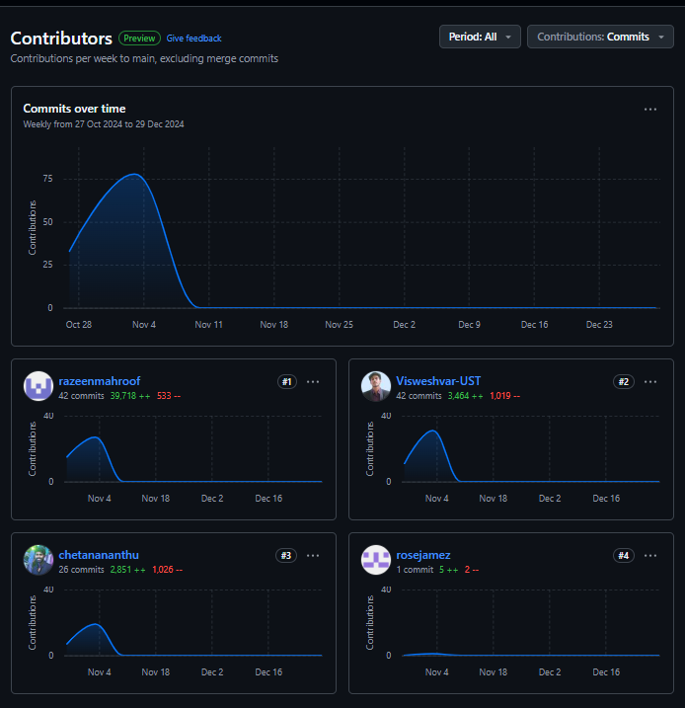
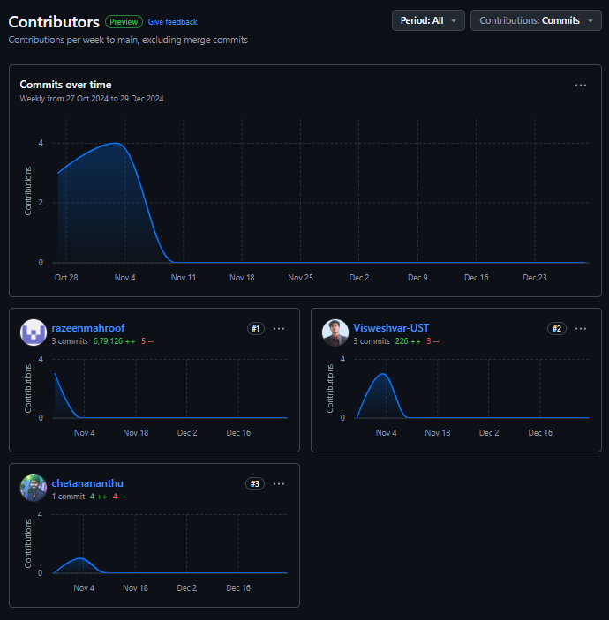
Project Management

Slide 11

Challenges and Solutions
Challenges:
State Management: Handling complex project and employee data states across microservices.
Employee Allocation: Ensuring accurate and efficient employee assignment to projects, considering budget and role restrictions.
Solutions:
Implemented a state management solution in the frontend for smooth data flow.
Developed a role-based allocation module, making employee assignment flexible and budget-compliant.

Slide 12
Future Enhancements
Messaging & Notification Service Integration: Real-time updates for budget thresholds, significant expenses, and attendance alerts.
Payment Gateway Integration: Facilitate secure payment processing for employee reimbursements and client payments.
Currency Conversion Integration: Provide accurate currency conversions for international transactions.
AI Integration for Employee Performance Analysis: Use AI to evaluate employee performance metrics, providing insights for project success and workforce development.

Slide 13

THANK you

